Slide 1




How Music Affects Retention
Brinda Narayanan, Carolyn Yatco, Katelyn Dang, Josue Sanchez, Rhea Bhutada

Slide 2
Table of contents
01
Introduction and Motivation
02
Research Question
Related Work / Background
03
04
Methods
05
Data Collection
06
Results
07
Analysis
08
Discussion
Notes:
In this presentation, we will first go through our Introduction and Motivation, along with our research question. We then touch on the background and related works, from class and outside of class. We will go on to explain our methods for conducting our research, and how we collected our data. Finally, we will explain and analyze our results, ending with a discussion of the strengths and limitations of our project, and what we learned along the way.

Slide 3


Introduction & Motivation
The Wide Use of Background Music when Studying
- The Mozart Effect
Speaker: Katelyn
Notes:
Our project is centered on how different genres of music affect listeners’ retention level. The motivation of this research is the fact that many students listen to music when studying. However, different people have different preferred genres. Hence, in this project, via measuring brain activity with neurosky, we would like to examine whether there is a difference in retention when a person listens to classical or heavy metal music. We also further our project to see whether a given word or image affects the attention of a person. In addition, as we did research for our experiment we discovered the Mozart Effect which theorizes that classical music improves intelligence. This is important because music is an important part of our lives, and there has been past studies that have shown that it can increase memory, attention, and intelligence all key ideas for students going through college. Therefore, we wanted to compare these results in action.

Slide 4

Research Question
Speaker: Katelyn
Does the genre of music and type of stimuli (word or image) improve recall retention?
Notes:
This leads us to our Research Question and Essentially our problem

Slide 5
Related Work/ Background
Mozart Effect
Music and Retention
Speaker: Katelyn
Verrusio, W, et al. “The Mozart Effect: A Quantitative EEG Study.” Science Direct, Academic Press, 29 May 2015, https://www.sciencedirect.com/science/article/abs/pii/S1053810015001130.
Makada, Tasnim, et al. “Enhancing Memory Retention by Increasing Alpha and Decreasing Beta Brainwaves Using Music: Proceedings of the 9th ACM International Conference on Pervasive Technologies Related to Assistive Environments.” ACM Digital Library, 1 June 2016, https://dl.acm.org/doi/abs/10.1145/2910674.2935851.
Notes:
To specify as well as consolidate our hypothesis, we sought evidences from a couple of related papers. The first one is a paper called Enhancing Memory Retention by increasing Alpha and decreasing Beta brainwaves using Music. We also found a paper that talked about the mozart effect in terms of its EEG pattern: The Mozart Effect: A quantitative EEG study. To analyze our results we used a t-test, which is a parametric test. This relates to work in class as it considers different brainwaves, and it taught us how to analyze EEG brainwaves.

Slide 6

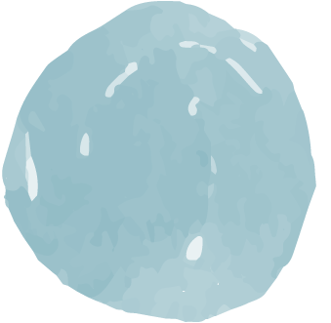
Methods - Overview
The Task
The Experiment
Speaker: Brinda
In order to test retention, we used a method known as “Paired Associate Task.” Each participant was presented with 15 word or 15 image pairs.
The experiment consisted of three separate trials with different stimuli (no music, heavy metal music, and classical music). Each trial had a separate task and post-test which measured the accuracy of their recall performance.

Slide 7

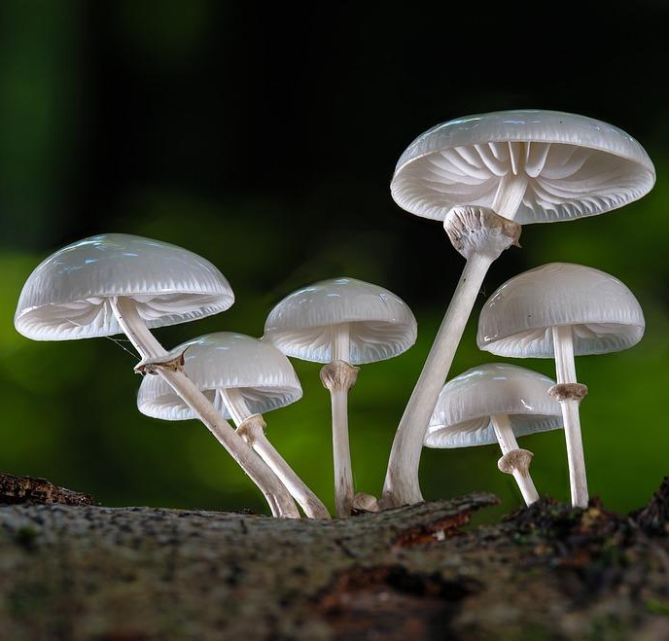
Methods - The Task
Speaker: Brinda
ladybug
mushroom
Each participant was asked to complete three paired associate learning tasks. The task consisted of paired images or words as follows:
Participants are presented with either 15 pairs of words or 15 pairs of images for five seconds (75 seconds total) with headphones for each condition
After 10 minutes - still listening to the music - the participant is asked to recall information about the pairs with a test. It contained questions involving:
Which items were paired
Which side an image was located
Post-test was 10 questions and accuracy of their recall performance was assessed
Experimenter sits behind participant for task & test, and participant sits in silence for ten minute break between task and test, for one minute between changing task and music.

Slide 8
Methods - The Experiment
Speaker: Brinda
Total Participants: 8
Counterbalanced the participants and conditions
4 completed word task and 4 completed image tasks
4 STEM majors and 4 non-STEM majors
4 males and 4 females
Everyone started with the no music condition first as a control, and depending on the person and their task, classical and heavy metal was switched in what came second.
Each data collection session consisted of three trials,(no music, heavy metal music, and classical music. During the trial, participants were:
Presented the Task
Asked to remember the 15 pairs (words or images) that are shown (5 seconds each)
During the task meditation scores were recorded using Neurosky headset/software & OpenVibe
Test Retention
After 10 minute waiting period, each participant was asked to take a 10 question test
Test consisted of 10 questions regarding the paired associate task
During the test meditation scores were recorded using Neurosky headset/software & OpenVibe
Notes:
For full credit there should be enough detail for someone relatively skilled to replicate your work.

Slide 9
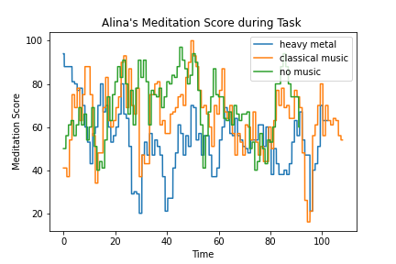
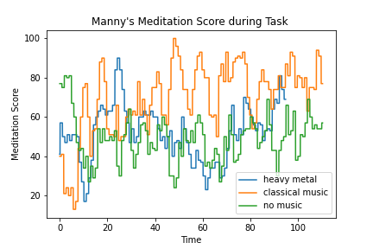
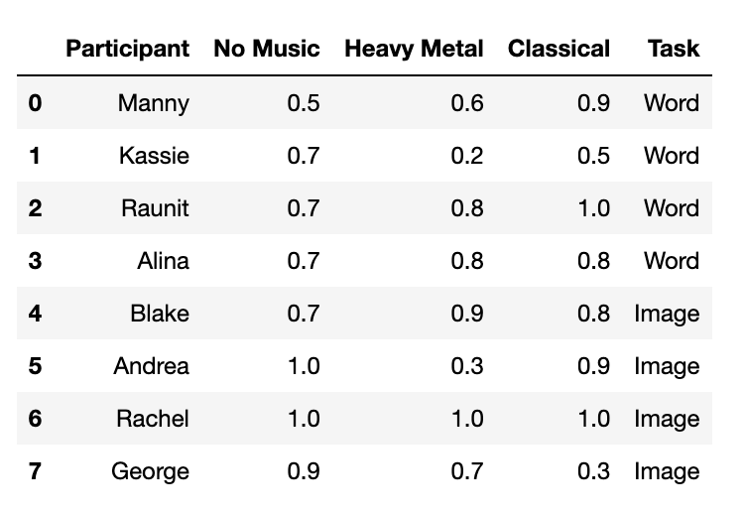
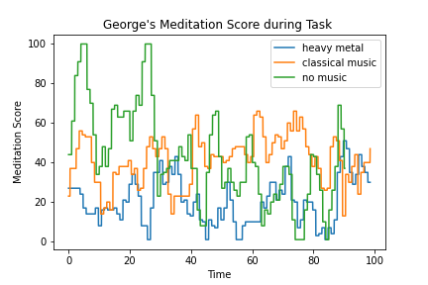
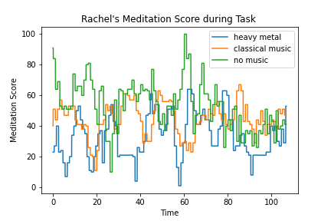
Results

Slide 10
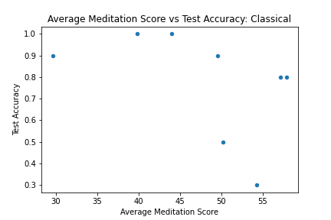
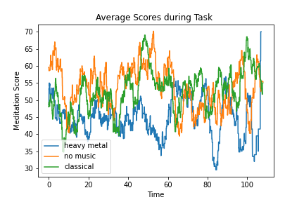
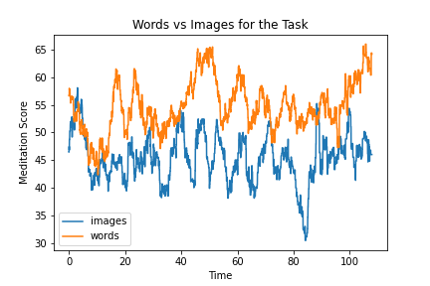
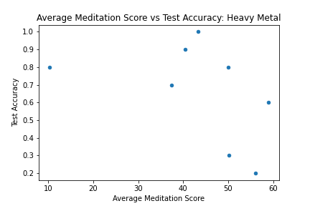
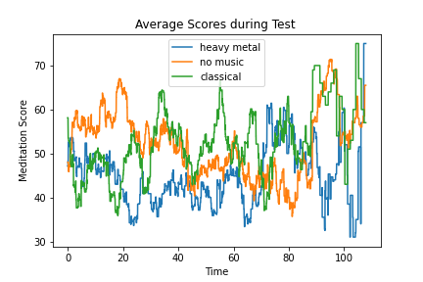
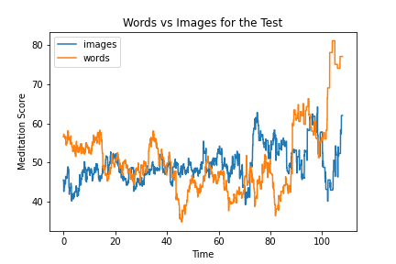
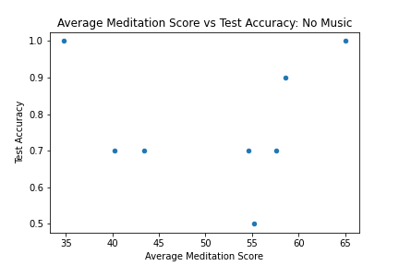
Results
https://docs.google.com/presentation/u/0/?authuser=0&usp=slides_web
Speaker: Carolyn
Notes:
Heavy metal was the lowest states
No music and classical were very similar in scores - not enough correlation to say that the classical music
-note: sample size was small so we can’t generalize or make too much cause and effect
Went Well: Testing overall went well, it was a hassle to figure it out, especially how to record and get the scores, but we did get everything to work properly. In addition, heavy metal was shown to have lower results in meditation score and retention score even though we didn’t many participants.
Not work as well as planned:
We didn’t get statisticially significant results for classical music, and in fact it was almost on pair with no music. This could have also been because no music is equivalent to silence and some people can focus better in that environment.

Slide 11
Results
Speaker: Carolyn
Heavy metal was the lowest states
No music and classical were very similar in scores - not enough correlation to say that the classical music
note: sample size was small so we can’t generalize or make too much cause and effect
What Went Well: Testing overall went well, it was a hassle to figure it out, especially how to record and get the scores, but we did get everything to work properly. In addition, heavy metal was shown to have lower results in meditation score and retention score even though we didn’t many participants.
Not work as well as planned: We didn’t get statisticially significant results for classical music, and in fact it was almost on pair with no music. This could have also been because no music is equivalent to silence and some people can focus better in that environment.
Notes:
Heavy metal was the lowest states
No music and classical were very similar in scores - not enough correlation to say that the classical music
-note: sample size was small so we can’t generalize or make too much cause and effect
Went Well: Testing overall went well, it was a hassle to figure it out, especially how to record and get the scores, but we did get everything to work properly. In addition, heavy metal was shown to have lower results in meditation score and retention score even though we didn’t many participants.
Not work as well as planned:
We didn’t get statisticially significant results for classical music, and in fact it was almost on pair with no music. This could have also been because no music is equivalent to silence and some people can focus better in that environment.

Slide 12
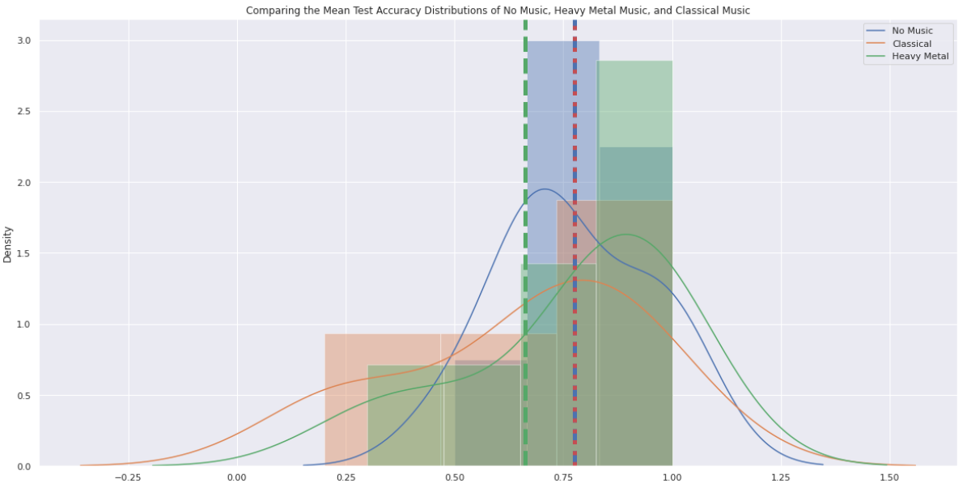
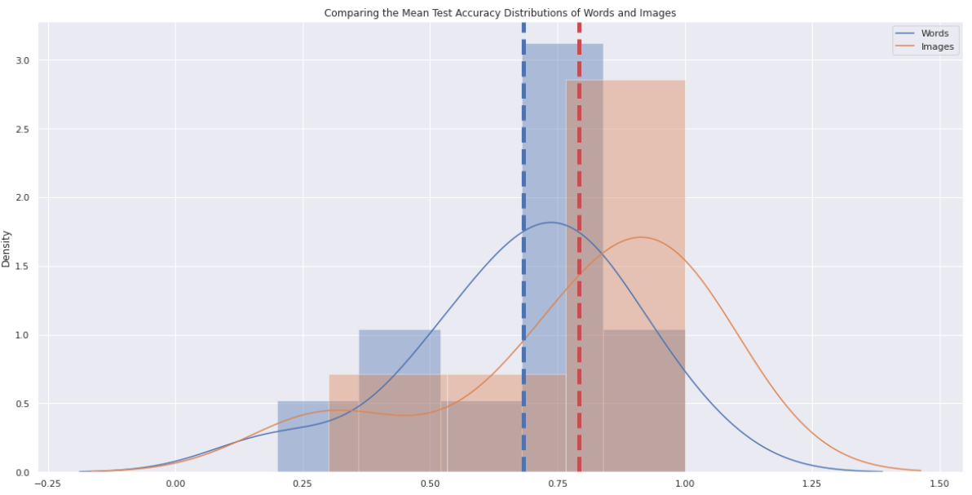
Analysis - Accuracy Scores (Plot)
Speaker: Rhea
Comparing the Mean Accuracy Score Distributions of No Music, Heavy Metal Music, and Classical Music
Comparing the Mean Accuracy Score Distributions of Words and Images
Notes:
To further test the significance of our data, we looked at the mean distribution of the accuracy scores for the post-test. We compared each stimuli including no music, heavy metal, and classical as well as the test conditions, whether the participant was tested with words or images.
These are the mean distribution graphs for the accuracy scores. On the left is the graph for the mean distributions of accuracy scores separated based on stimuli. And on the right is the graph for the mean distribution of accuracy scores separated based on test condition. When looking at the graph on the left, it is clear that the mean distribution of accuracy scores under heavy metal music is much lower than that of no music and classical music. When looking at the graph on the right, it is appears that the mean distribution of accuracy scores for words is lower than that of images.

Slide 13
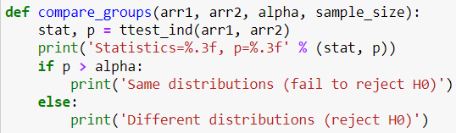
Analysis - Accuracy Scores (T-Test)
Speaker: Rhea
No Music vs Heavy Metal Music:
H₀: The mean accuracy score is the same between no music and heavy metal music.
T-statistic: 1.655
P-value: 0.120
Alpha: 0.05
We fail to reject the null hypothesis; there is no significant difference between the mean accuracy score of no music and that of heavy metal music.
No Music vs Classical Music:
H₀: The mean accuracy score is the same between no music and classical music.
T-statistic: -0.401
P-value: 0.694
Alpha: 0.05
We fail to reject the null hypothesis; there is no significant difference between the mean accuracy score of no music and that of classical music.
Heavy Metal Music vs Classical Music:
H₀: The mean accuracy score is the same between heavy metal music and classical music.
T-statistic: -2.951
P-value: 0.011
Alpha: 0.05
We reject the null hypothesis; there is a significant difference between the mean accuracy score heavy metal and that of classical music.
Words vs Images:
H₀: The mean accuracy score is the same between word paired associate task and image paired associate task.
T-statistic: 0.233
P-value: 0.818
Alpha: 0.05
We fail to reject the null hypothesis; there is no significant difference between the mean accuracy score of word paired associate task and image paired associate task.
**this is the function we implemented to calculate and interpret our T-Test**
Notes:
To see the significance of our results, we conducted several two-sample t-tests that compared the mean distribution of accuracy scores for each of the stimuli as well as the test conditions. We believe that the t-test would be a sufficient parametric test since we had a small number of samples and our observations of different individuals were outcomes of statistically independent, normally distributed, and random variables.
In total, four t-tests were conducted comparing the accuracy scores between no music vs classical music, no music vs heavy metal music, heavy metal music vs classical music, and lastly words vs images. For each of the two-sample t-tests conducted, we assumed our null hypothesis to be that there was no significant difference between the mean distribution of accuracy scores. To calculate the t-statistic and p-value, we used scipy’s built in function ttest_ind and compared it to an alpha of 0.05. This can be seen in this screenshot of our compare_group function.
Overall, after conducting the two-sample t-tests, we found that there was no significant difference between the mean distribution of accuracy scores between no music and classical music, no music and heavy metal music, and words and images. As a result, for those tests, we failed to reject the null hypothesis.
However, we did find there to be a significant difference between the mean distribution of accuracy scores between heavy metal music and classical music. In this case, we rejected the null hypothesis as there is a significant difference between the mean accuracy scores of heavy metal music and classical music.

Slide 14
Analysis - Accuracy Scores (T-Test)
Speaker: Rhea
To see the significance of our results, we conducted several two-sample t-tests that compared the mean distribution of accuracy scores for each of the stimuli as well as the test conditions.
We believe that the t-test would be a sufficient parametric test since we had a small number of samples and our observations of different individuals were outcomes of statistically independent, normally distributed, and random variables.
Notes:
To see the significance of our results, we conducted several two-sample t-tests that compared the mean distribution of accuracy scores for each of the stimuli as well as the test conditions. We believe that the t-test would be a sufficient parametric test since we had a small number of samples and our observations of different individuals were outcomes of statistically independent, normally distributed, and random variables.
In total, four t-tests were conducted comparing the accuracy scores between no music vs classical music, no music vs heavy metal music, heavy metal music vs classical music, and lastly words vs images. For each of the two-sample t-tests conducted, we assumed our null hypothesis to be that there was no significant difference between the mean distribution of accuracy scores. To calculate the t-statistic and p-value, we used scipy’s built in function ttest_ind and compared it to an alpha of 0.05. This can be seen in this screenshot of our compare_group function.
Overall, after conducting the two-sample t-tests, we found that there was no significant difference between the mean distribution of accuracy scores between no music and classical music, no music and heavy metal music, and words and images. As a result, for those tests, we failed to reject the null hypothesis.
However, we did find there to be a significant difference between the mean distribution of accuracy scores between heavy metal music and classical music. In this case, we rejected the null hypothesis as there is a significant difference between the mean accuracy scores of heavy metal music and classical music.

Slide 15
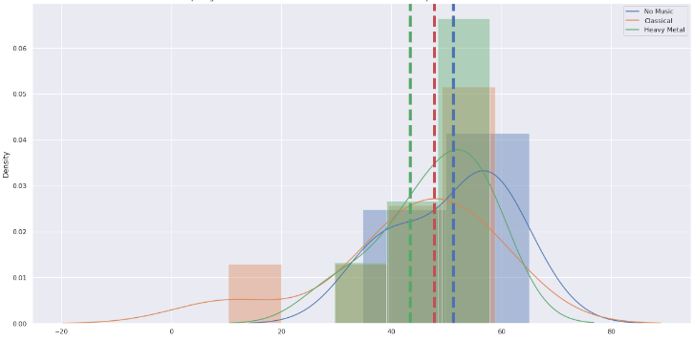
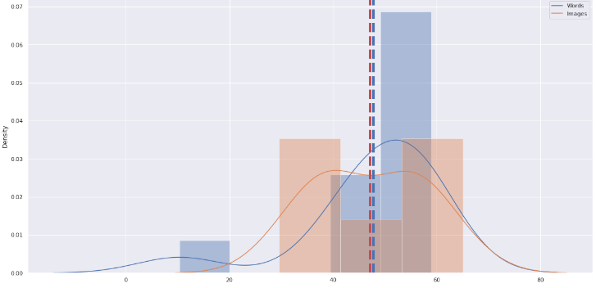
Analysis - Meditation Scores (Plot)
Comparing the Mean Meditation Score Distributions of No Music, Heavy Metal Music, and Classical Music
Comparing the Mean Meditation Score Distributions of Words and Images
Speaker: Rhea
Notes:
Similar to accuracy scores, we looked at the mean distribution of the meditation scores collected during the experiment. Again, we compared each stimuli including no music, heavy metal music, and classical music as well as the test conditions, whether the participant was tested with words or images.
These are the mean distribution graphs for the meditation scores. On the left is the graph for the mean distributions of accuracy scores separated based on stimuli. And on the right is the graph for the mean distribution of meditation scores separated based on test condition. When looking at the graph on the left, it is clear that the mean distribution of meditation scores under no music is higher than that of heavy metal music and classical music. When looking at the graph on the right, it is appears that the mean distribution of meditation scores for words is slightly higher than that of images.

Slide 16
Analysis - Meditation Scores (T-Test)
Speaker: Rhea
No Music vs Heavy Metal Music:
H₀: The mean meditation score is the same between no music and heavy metal music.
T-statistic: 4.270
P-value: 0.001
Alpha: 0.05
We reject the null hypothesis; there is a significant difference between the mean meditation score of no music and that of heavy metal music.
No Music vs Classical Music:
H₀: The mean meditation score is the same between no music and classical music.
T-statistic: 3.334
P-value: 0.005
Alpha: 0.05
We reject the null hypothesis; there is a significant difference between the mean meditation score of no music and that of classical music.
Heavy Metal Music vs Classical Music:
H₀: The mean meditation score is the same between heavy metal music and classical music.
T-statistic: -0.894
P-value: 0.387
Alpha: 0.05
We fail to reject the null hypothesis; there is no significant difference between the mean meditation score of heavy metal and that of classical music.
Words vs Images:
H₀: The mean meditation score is the same between word paired associate task and image paired associate task.
T-statistic: -1.146
P-value: 0.264
Alpha: 0.05
We fail to reject the null hypothesis; there is no significant difference between the mean accuracy score of word paired associate task and image paired associate task.
**this is the function we implemented to calculate and interpret our T-Test**
Notes:
Again, we conducted several two-sample t-tests that compared the mean distribution of mediation scores for each of the stimuli as well as the test conditions. We believe that the t-test would be a sufficient parametric test since we had a small number of samples and our observations of different individuals were outcomes of statistically, independent, normally distributed, and random variables.
In total, four t-tests were conducted comparing the meditation scores between no music vs classical music, no music vs heavy metal music, heavy metal music vs classical music, and lastly words vs images. For each of the two-sample t-tests conducted, we assumed our null hypothesis to be that there was no significant difference between the mean distribution of meditation scores. To calculate the t-statistic and p-value, we used scipy’s built in function ttest_ind and compared it to an alpha of 0.05. This can be seen in this screenshot of our compare_group function.
Overall, after conducting the two-sample t-tests, we found that there was no significant difference between the mean distribution of meditation scores between heavy metal music and classical music as well as words and images. As a result, for those tests, we failed to reject the null hypothesis.
However, we did find there to be a significant difference between the mean distribution of meditation scores between no music and heavy metal music as well as no music and classical music. In both cases, we rejected the null hypothesis as there is a significant difference between the mean meditation scores of no music and heavy metal music as well as a significant difference between the mean meditation scores of no music and classical music.

Slide 17
Analysis - Overview
Accuracy Scores
Meditation Scores
Speaker: Rhea
The accuracy scores for heavy metal were significantly worse than that of classical music.
The meditation scores for both classical music and heavy metal music were significantly worse than that of no music.
Notes:
When considering the accuracy scores, we notably saw that there was a statistically significant difference between the accuracy scores for heavy metal music and classical music. As a result, the accuracy scores for heavy metal were significantly worse than that of classical music.
When considering the meditation Scores, we notably saw that there was a statistically significant difference between the meditation scores for no music and heavy metal music. Additionally, there was a statistically significant difference between the meditation scores for no music and classical music. As a result, The meditation scores for both classical music and heavy metal music were significantly worse than that of no music.

Slide 18


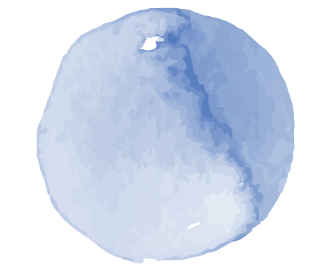
Discussion
You can enter a subtitle here if you need it
Speaker: Josue
Learning how to use the EEG headset software to gather data from participants was tough in the beginning. Even with the data gathered, it still was not too clear but it worked and gave us results. Although the study found that music paired with stimuli does have an effect on recall, the data is not precise enough.
For future research, a better headset would give more accurate results. The headset used in this study, only gathered results for an average meditation score. This means that the measured brain activity may not be correlated towards working memory.
More participants would allow for a clear picture of the study. Although we had 8 participants, the sample size is not large enough to say that this could apply to the general public. The larger the sample size the better the results for this type of study.
Notes:
What did you learn?
How much work did you do?

Slide 19
Strengths & Limitations
Speaker: Josue
Strengths
Three different groups gave clear results for the study (Control, Classical, Heavy Metal).
Approach allowed for visualizations to be clear, which gave a better statistical analysis.
Having EEG data gave the comparison of meditation and score results of participants and find if any correlation was between them.
Limitations
Sample size of participant was small, which does not allow for the study to assume that this applies to a general population.
Does not take into account any other genres’ of music which could have an impact on recall.
EEG headset does not give specific bands(Alpha, Beta, Gamma) but rather a general guide of brain waves.
Notes:
How hard was what you did/tried to do?
Are you aware of the strengths and limitations of your approach/algorithm?

Slide 20

Conclusion
Speaker: Josue
The results show that the genre of music playing while paired with a stimuli can affect recall information. So if you’re someone who is studying or working, your music choice affects your ability to recall information. For clear results of this study, a larger group of participants will be necessary to gather more data and form a definitive answer, as the current sample size allows for a hypothetical conclusion.

Slide 21
Reference
Makada, Tasnim, et al. “Enhancing Memory Retention by Increasing Alpha and Decreasing Beta Brainwaves Using Music: Proceedings of the 9th ACM International Conference on Pervasive Technologies Related to Assistive Environments.” ACM Digital Library, 1 June 2016, https://dl.acm.org/doi/abs/10.1145/2910674.2935851.
Verrusio, W, et al. “The Mozart Effect: A Quantitative EEG Study.” Science Direct, Academic Press, 29 May 2015, https://www.sciencedirect.com/science/article/abs/pii/S1053810015001130.

Slide 22
Thank you for Watching

